Slide 1

Neural Substrates of Attention and Awareness
Dan Birman
Gardner Lab
Lightning Talks – 2015-04-23

Slide 2
Is Attention Necessary
for Awareness?
Notes:
This project starts with a question: “Is attention necessary for awareness?“ A lot of people have asked this before—let me demonstrate some of the answers that they have arrived at.

Slide 3
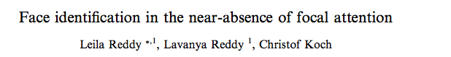


Notes:
Here is a classic task: you’re attending to these characters looking to see if there is an L among the Ts and a face flashes in the periphery. Most of the people in this room will have identified the gender of the face from that brief unexpected presentation

Slide 4
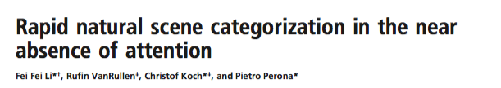
Notes:
Here again, same task, this time most of the people in the audience will have noticed that the scene was a city. So here were two examples of the “No” answer: you didn’t direct attention to the face or the scene, but you were aware of their properties.

Slide 5

Notes:
Let’s try a different example now. I want you to pay attention to motion and count the planes as they cross the screen.

Slide 6

Notes:
Ready? Here we go.
Now, you were directing your attention at motion, and in the background you were unaware of several changes that happened. Let me highlight them and then switch back to the original image.

Slide 7
Notes:
So we have a conundrum, in some situations attention seems to be essential and in others its unnecessary!

Slide 8
What is Attention?
What do we mean by Awareness?
Notes:
But I think there’s a solution here: we’re discussing attention as if it were a single process.

Slide 9
What is Attention?
What do we mean by Awareness?
Attention feels unitary—but its neural implementation takes on many different forms, depending on the attended feature
Notes:
Even though we intuitively we feel like attention is always the same, its implementation in the brain changes depending on the situation and the attended feature.

Slide 10
What is Attention?
What do we mean by Awareness?
Attention feels unitary—but its neural implementation takes on many different forms, depending on the attended feature
With a more precise definition of attention we can make predictions: how might contrast and motion, two basic visual features, interact?
Notes:
We know a lot about some features in the brain, like contrast and motion, it seems like we should be able to make strong predictions about how attention to one feature will affect the other.

Slide 11
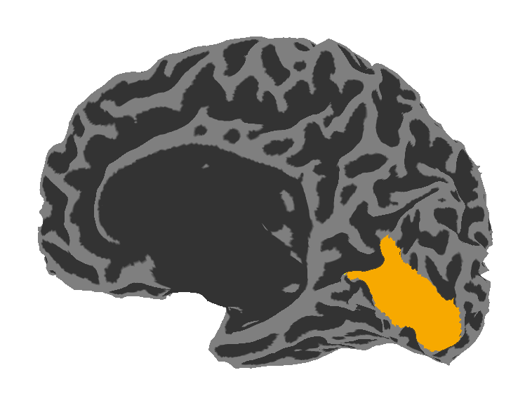
High Contrast
Low Contrast
Visual Area V1: Contrast
Notes:
We know that contrast is represented by neurons the first cortical visual area: V1, and we know that V1 is sufficient to account for most of our perception of contrast. We also know that attention to contrast causes very specific changes in V1.

Slide 12
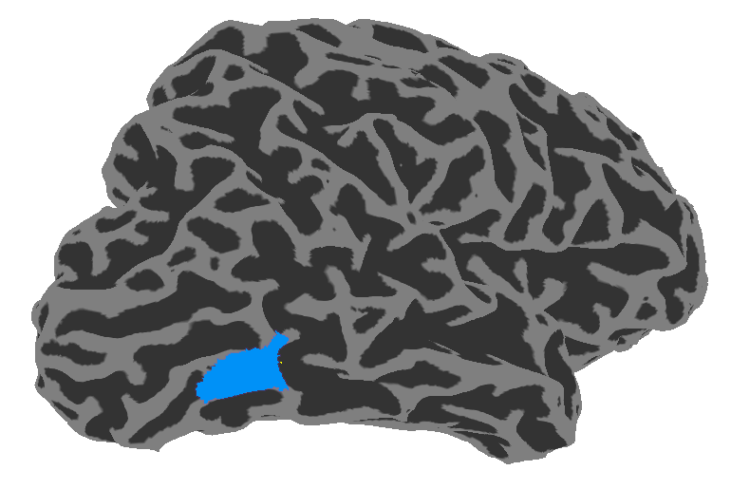
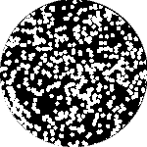
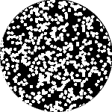
High Contrast
Low Contrast
Visual Area V1: Contrast
Visual Area hMT: Motion
0% Coherence
100% Coherence
Notes:
In a similar way, responses in area MT account for most of our perception of motion and attention to motion affects MT responses.

Slide 13
V1 projects strongly into MT
Reverse connections are weak
Prediction:
Attention to Contrast should alter the Perception of Motion
Attention to Motion should have no effect on Contrast
Notes:
We also know that V1 and MT are connected, but that most of the connections go in one direction. So this gives us a straightforward prediction: contrast should affect the perception of motion, but not vice versa.
The next step is to test this!

Slide 14
Contrast / Motion Discrimination Task
Prediction: Attention to contrast will diminish motion perception;
attention to motion will not affect contrast perception.
Task used to estimate % intensity change necessary for discrimination
Attend to one feature for 100 trials per block
15% of trials are “miscued”—you are asked, after the stimulus, to respond about the unattended feature
500 ms stimulus
+ 250 ms mask
Response:
Left / Right
Notes:
I won’t go into all of the details, but suffice to say the task we used is similar to the ones you saw earlier: participants pay attention to one feature and then rarely and unexpectedly they are asked about the unattended feature. This task gives us an estimate of how much of an increase in contrast or motion is needed to perceive a difference between two stimuli.

Slide 15
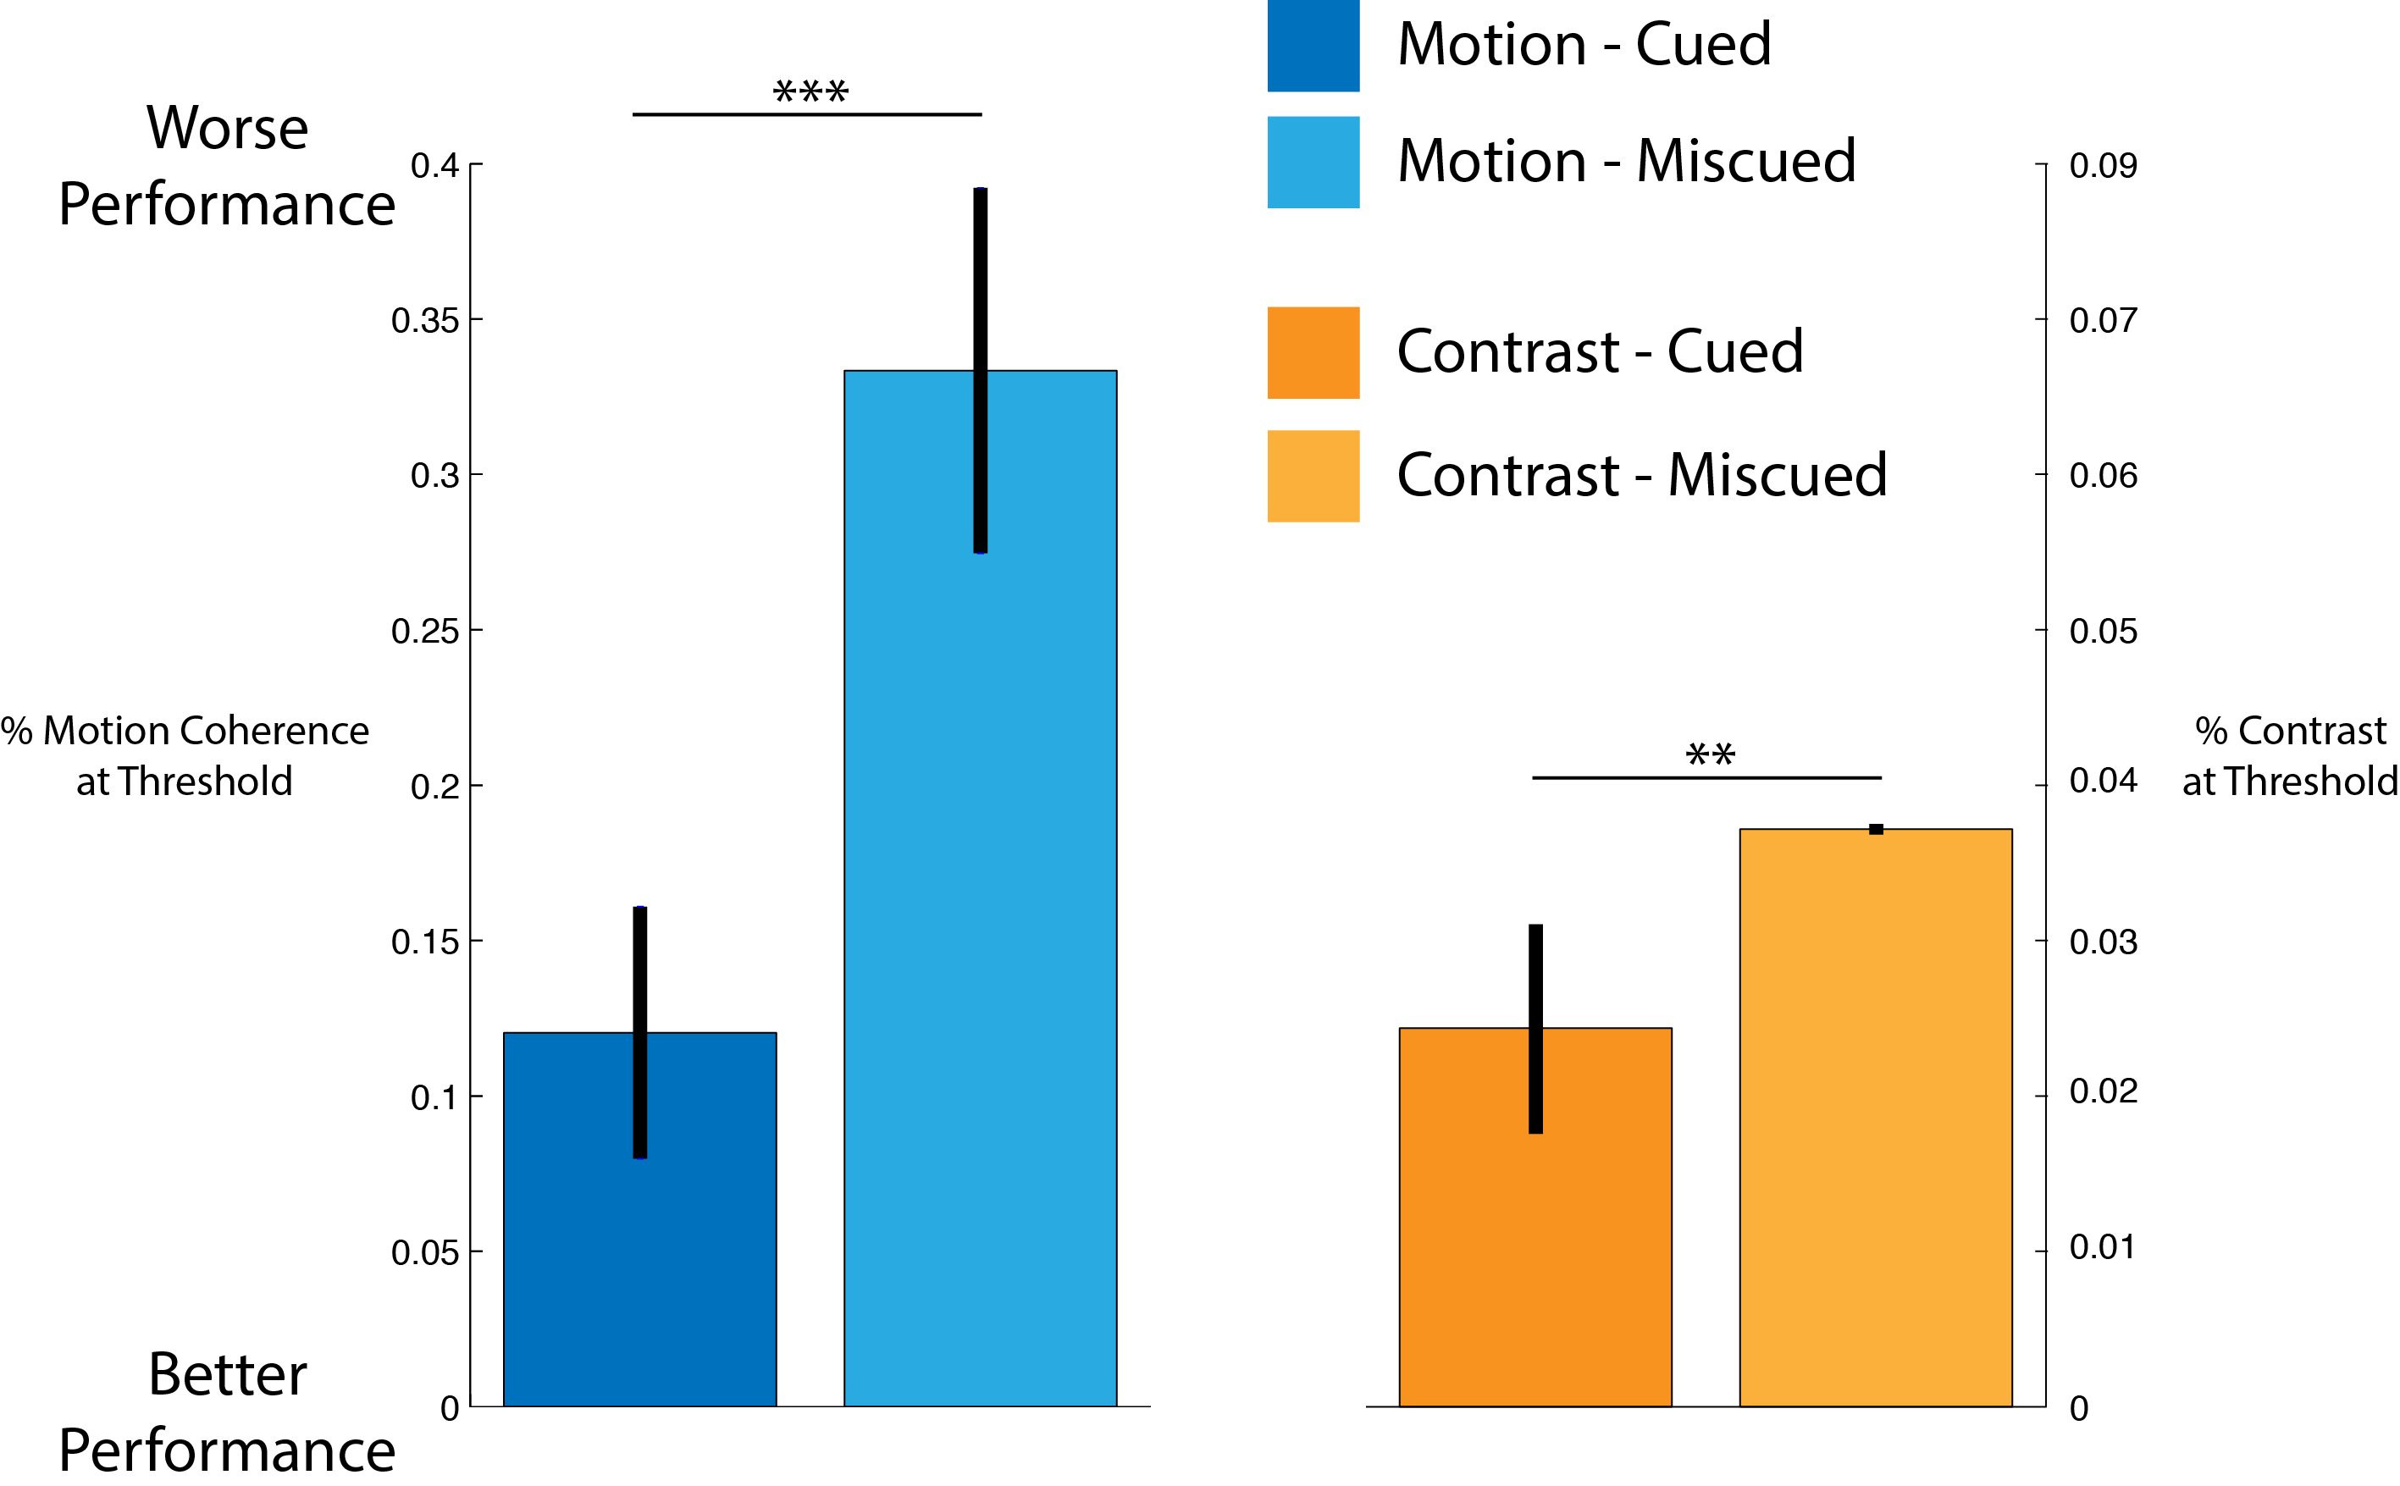
Notes:
What happens? Well, when you attend to motion and you respond about the motion you are quite good. It takes about a 10% increase in dots moving coherently to perceive that one side is moving more than the other.

Slide 16
Notes:
But when you are miscued, so you were cued to contrast but responded about motion, it takes 3x as many dots to get the same performance.

Slide 17
Notes:
Contrast behaves a bit differently, you need about a 2-3% difference in contrast to be successful,

Slide 18
Notes:
And that only increases slightly when you are miscued.
This is exactly the kind of asymmetry that we expect—where contrast perception is only weakly affected by attention to motion, but motion perception is strongly affected by contrast!!

Slide 19
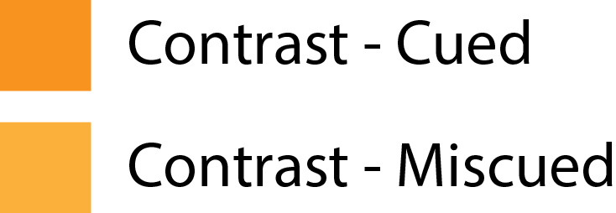
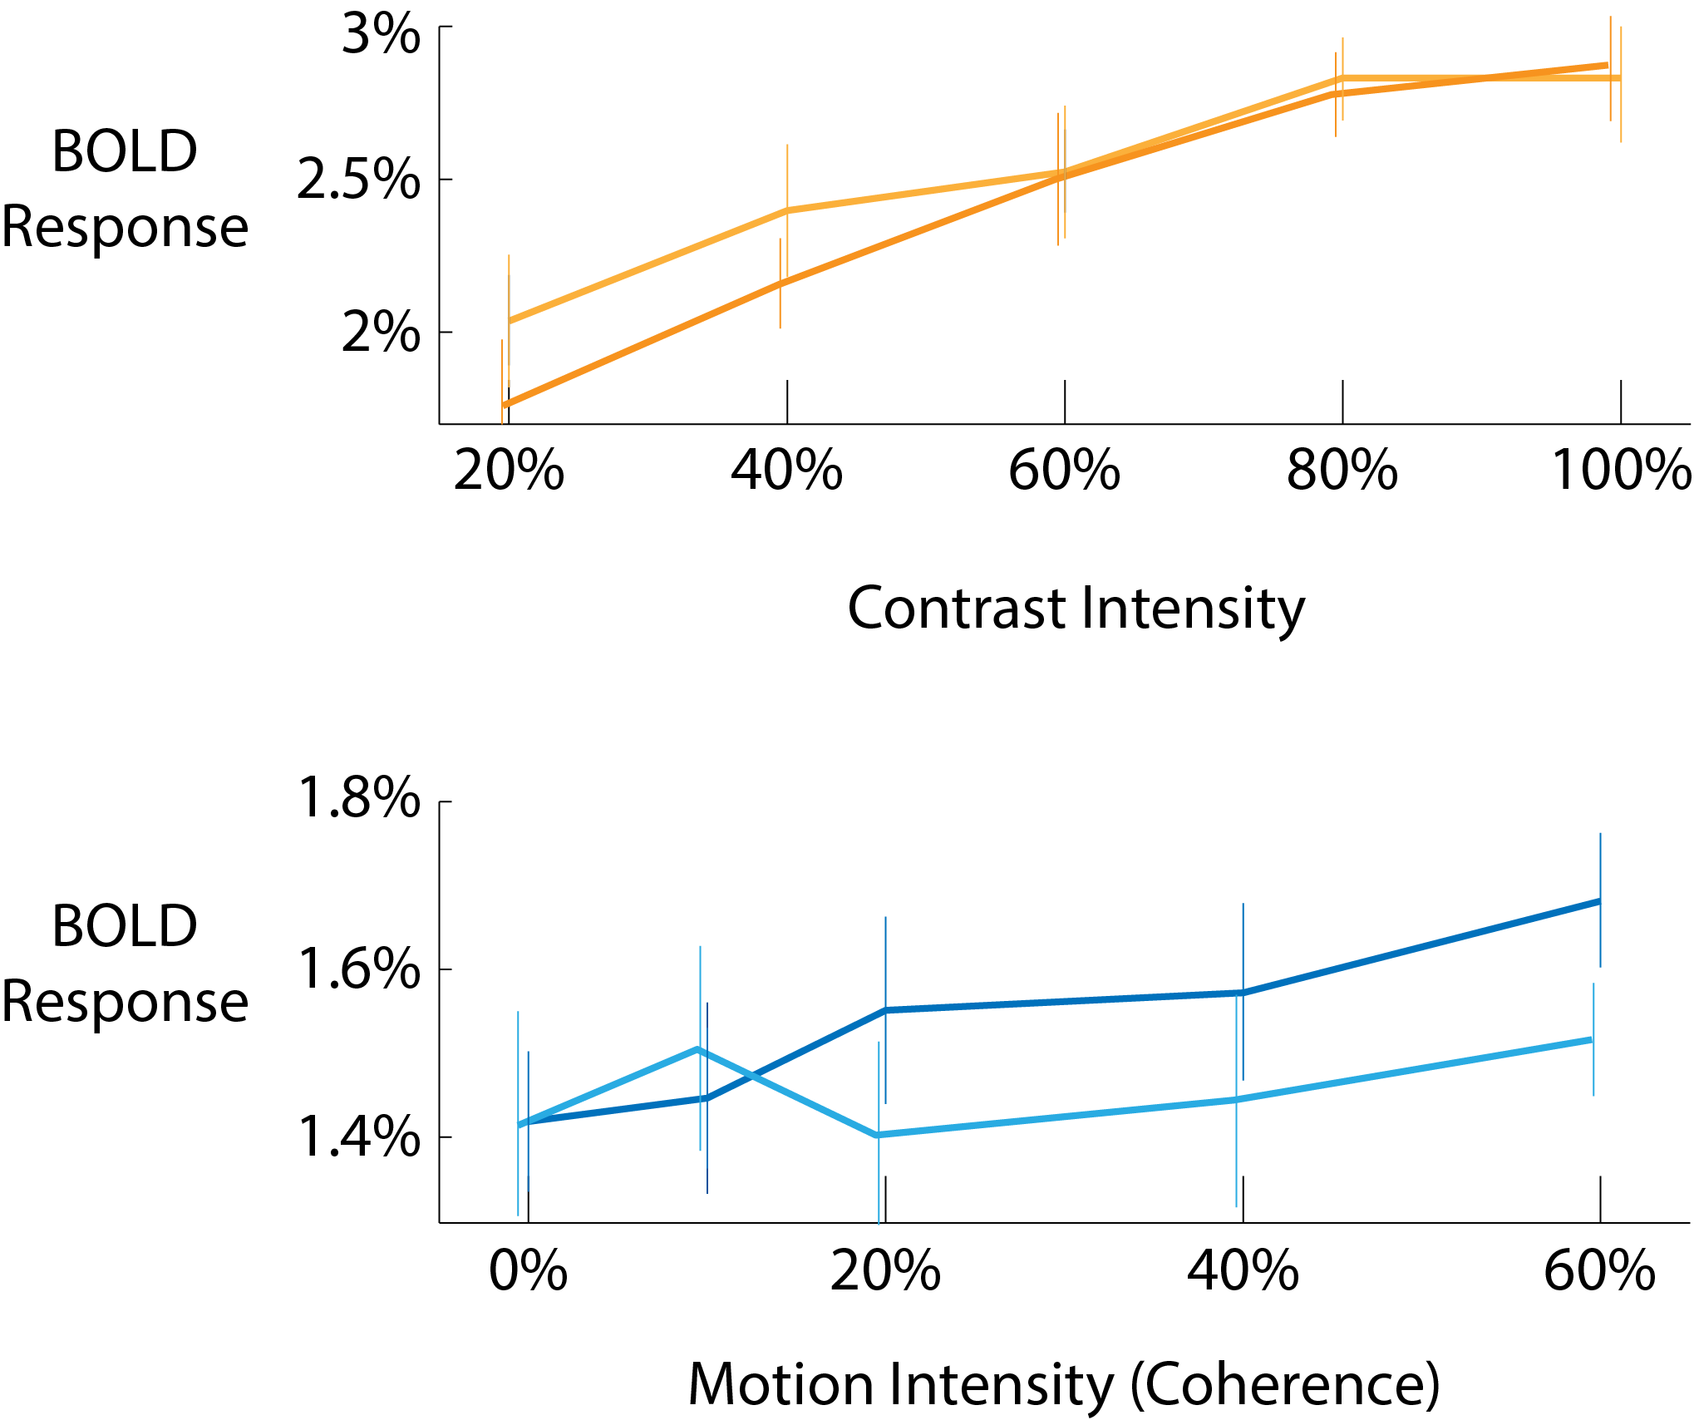



Notes:
When we look at the fMRI responses in areas V1 and MT we see a pattern that gives us a hint about why this might be happening. Again, I won’t go into detail, but notice that in both attention conditions the contrast response stays constant. But—there is almost no response to motion when participants were cued to attend to contrast.
Attending to contrast is directly affecting the perception of motion
Again, these results confirm our prediction, and fit well with what we know about the brain’s anatomy

Slide 20
Is Attention necessary for Awareness?
Notes:
So to come back to the original question: Is attention necessary for awareness?

Slide 21
It depends!
Is Attention necessary for Awareness?
Interactions occur only where strong connections exist between neural representations
Notes:
The answer is—it depends!

Slide 22
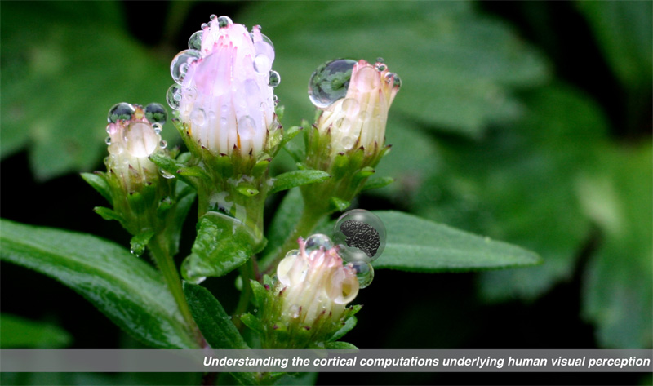

Gardner Lab @ Stanford University
Justin Gardner
Notes:
Thank you!

